Slide 1
Secured Insurance Framework Using Blockchain
Afeefa K H
Roll No : 3
S4 MCA - A

Slide 2
Relevance of the topic
Traditional insurance policy settlement is a manual process that is never hassle-free.
There are many issues, such as hidden conditions from the insurer or fraud claims by the insured, making the settlement process rough.
This process also consumes a significant amount of time that makes the process very inefficient.
This whole scenario can be disrupted by the implementation of blockchain and smart contracts in insurance.
Blockchain and innovative contract technology can provide immutable data storage, security, transparency, authenticity, and security while any transaction process is triggered.
With the implementation of blockchain, the whole insurance process, from authentication to claim settlement, can be done with more transparency and security

Slide 3
Description of the project
Its primary goal is to use blockchain and smart contracts to ensure secure, insurance fraud-free transactions.
It is to be noted that it is supposed to be a framework for an insurance company
This framework covers client registration, agent registration, insuring a policy etc. and by using blockchain technology, making the whole insurance system more robust.
The client will be able to register and request for a policy with the help of their corresponding agent and can make payment.
The agent is fully responsible for submitting all client requests within the network and they can view the details of the clients.
Admin can add policies , accept agents and issue and claim the policies for clients

Slide 4
Objectives of the study
The objectice is to create an insurance ecosystem using blockchain technology.
The objective of secured insurance framewrok using is to provide immutable data storage, security, transparency, authenticity, and security while any transaction process is triggered.

Slide 5
Existing System
Existing insurance systems have achieved a certain degree of automated processing. However, due to the lack of a single trusted source of state information of different transactions, they still suffer from performance bottlenecks.
The generic insurance systems require manual interactions across different transaction processes, hence resulting in slow processing, and lengthy payment settlement time.
Due to similar issues, the insurance industry is also facing the challenges of detecting claim frauds , which can otherwise be handled efficiently using blockchain-enabled smart contracts

Slide 6
Proposed System
The idea behind the model is to implement the processes of an insurance company as smart contracts, and place the contracts in a blockchain-enabled distributed platform, for both execution of the contracts and storage of the results.

Slide 7
Input and Output modules
Clients : The main character that is directly involved in the model is the client. They can signup , request insurance policies, make payment and with the help of their corresponding agent.
Agents : They control important features like policy accepting, The agent panel interface can control all the features, including looking into clients’ lists, the agency policy lists, the transaction history.
Admin : Responsible for issuing and claiming project,add new policies accepting agents

Slide 8
Front End/Back End/Tools
HTML : The HyperText Markup Language, or HTML is the standard markup language for documents designed to be displayed in a web browser. It can be assisted by technologies such as Cascading Style Sheets and scripting languages such as JavaScript.
CSS : Cascading Style Sheets is a style sheet language used for describing the presentation of a document written in a markup language such as HTML.
Python : Python is a computer programming language often used to build websites and software, automate tasks, and conduct data analysis.

Slide 9
Ganache : Ganache is used for setting up a personal Ethereum Blockchain for testing your Solidity contracts
Truffle : Truffle is a world-class development environment, testing framework and asset pipeline for blockchains using the Ethereum Virtual Machine (EVM)
Web 3 : Web3 is a new iteration of the world wide web that hosts decentralized apps that run on blockchain technology.

Slide 10
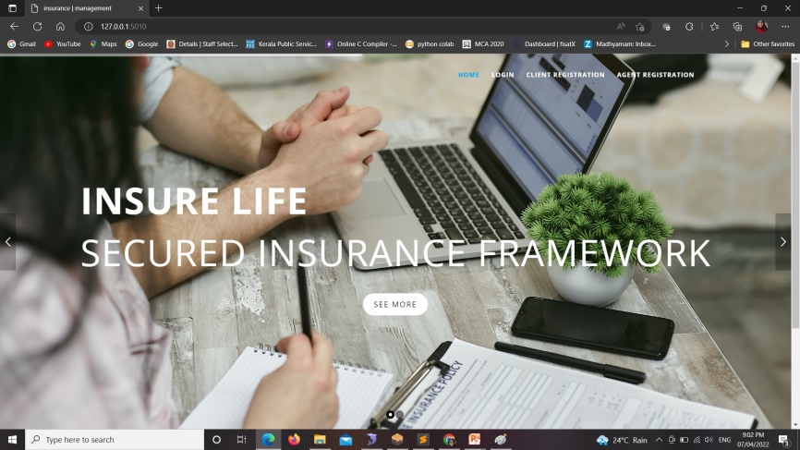
Sample Screenshots
Home Page

Slide 11
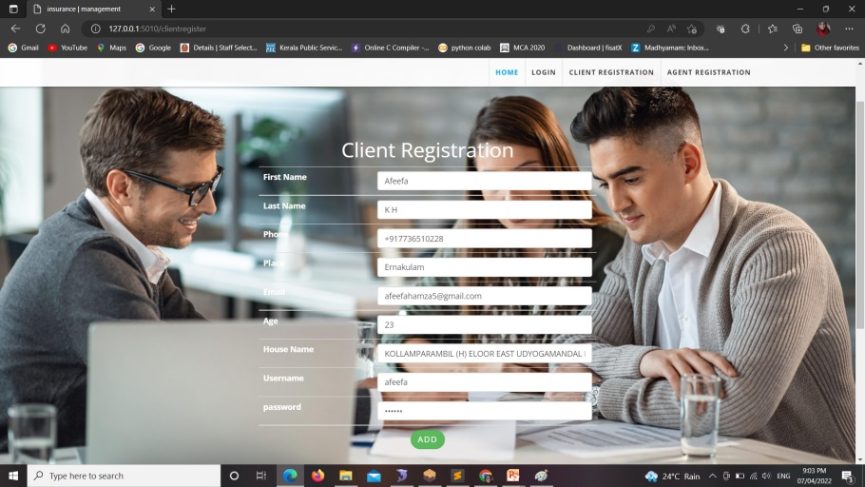
Client Regsitration

Slide 12
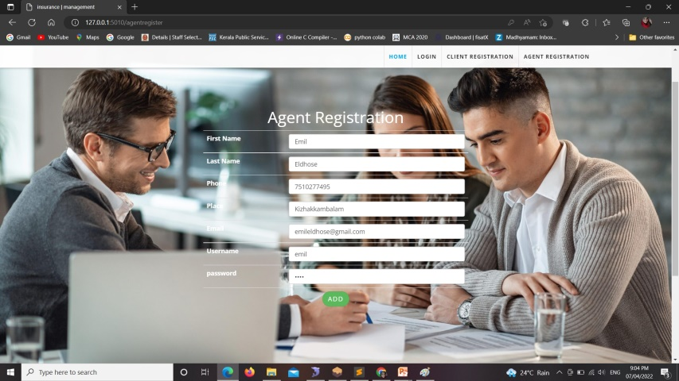
Agent Registration

Slide 13
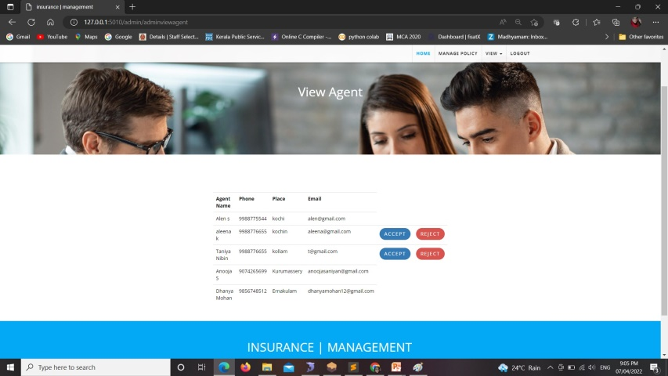
View Agent

Slide 14
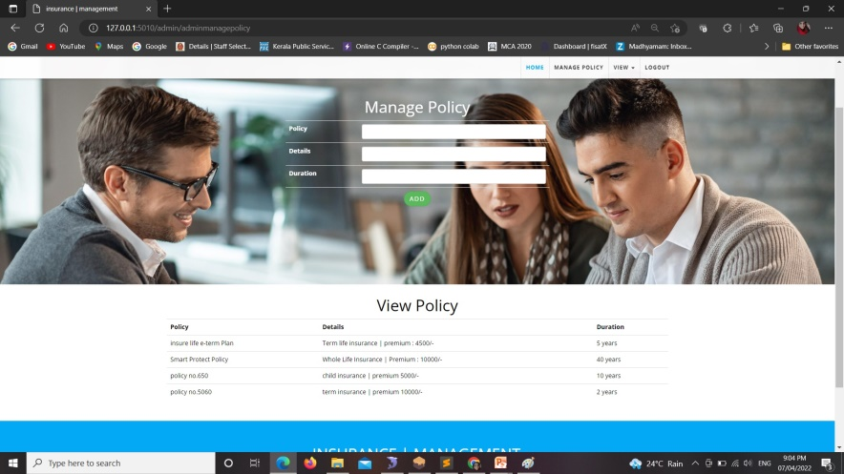
View and Add policy

Slide 15
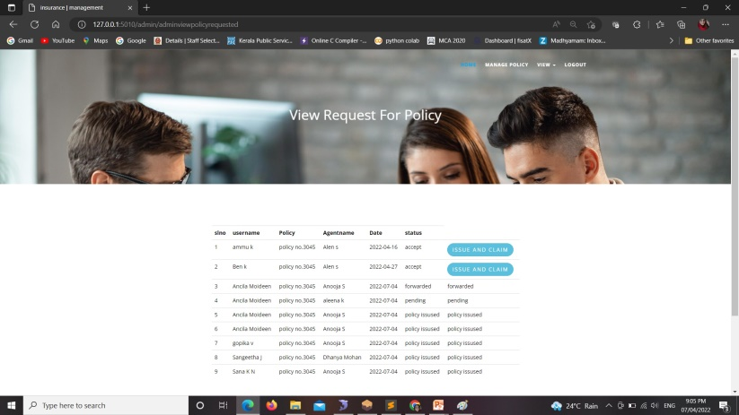
View Policy request

Slide 16
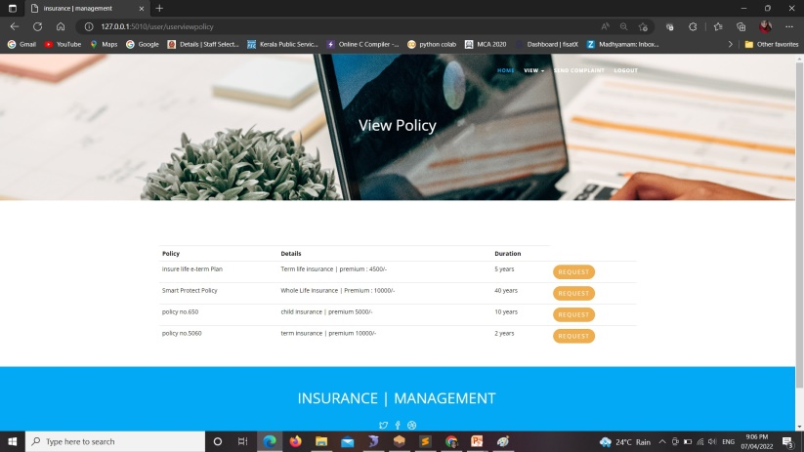
View Policy

Slide 17
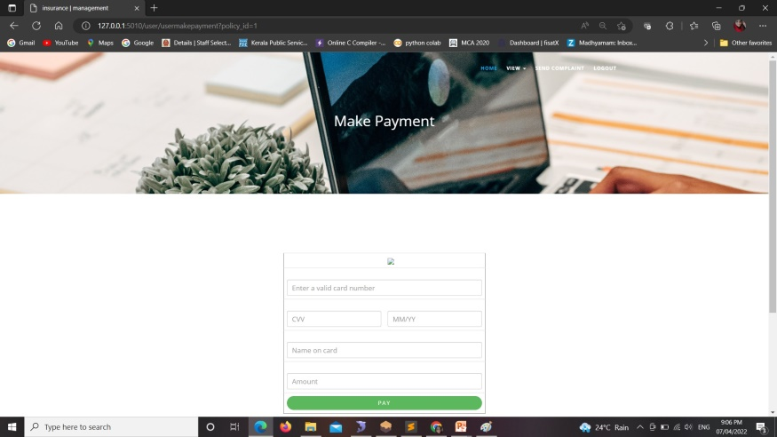
Make Payment

Slide 18
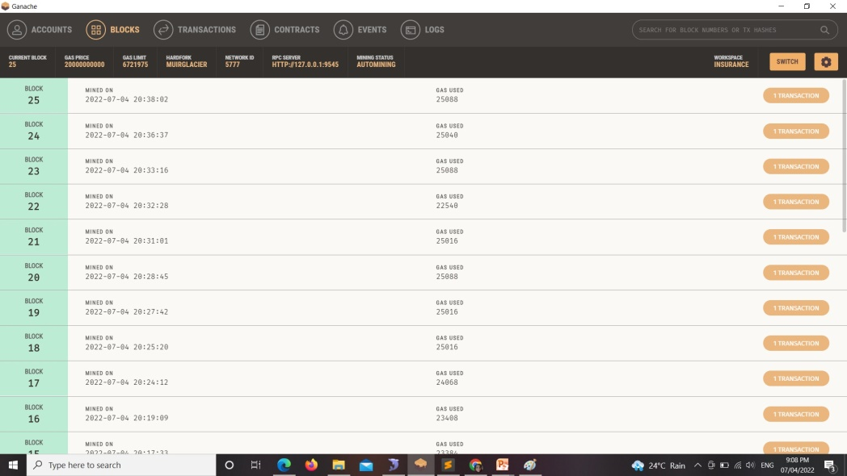
View Blocks

Slide 19
THANK YOU

